Slide 1

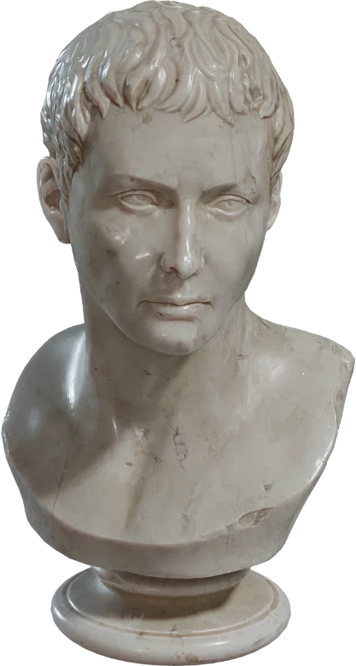
Augmented Reality Proposal - Statue mapping
New Collection · 2022
2018204050 김동욱 2017204094 안희승 2018204047 신정훈

Slide 2
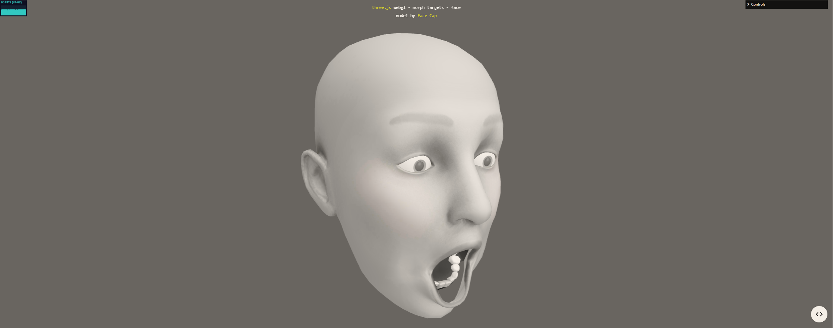
Motivation
Threejs examples | Inspired by this example; https://threejs.org/examples/?q=face#webgl_morphtargets_face

Slide 3
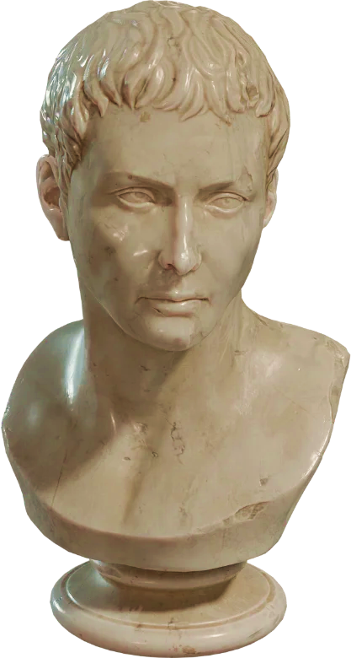
Procedures
Overall procedures be like:
Set basis using Three.js
Get face mesh detector from mediapipe
Get 3D face model from https://polyhaven.com/a/marble_bust_01
Import 3D model to Three.js (GlTF)
Map Face mesh landmarks to the 3D face model

Slide 4


Further updates…
Effects
Body synchronzing
aesthetic filters
distortion
vfx
Pose tracking
Inverse kinematics
Rigging

